Slide 1
Hadoop Distributed File System (HDFS)
Hadoop Distributed File System (HDFS)
Agenda
Introduction Hadoop
Hadoop eco-system
Definition
Architecture
HDFS
HDFS Components
Agenda
Notes:
11

Slide 2
Introduction to Big Data and Hadoop
The underlying Technology was invented by Google and developed by Doug Cutting
Hadoop is designed to efficiently process large volumes of information by connecting many commodity computers together to work in parallel.
Big data is a term applied to data sets whose size is beyond the ability of commonly used software tools to capture, manage, and process the data within a tolerable elapsed time. Big data sizes are a constantly moving target currently ranging from a few dozen terabytes to many petabytes of data in a single data set.
Examples
web logs,
sensor networks,
social networks,
Internet search indexing,
call detail records,

Slide 3
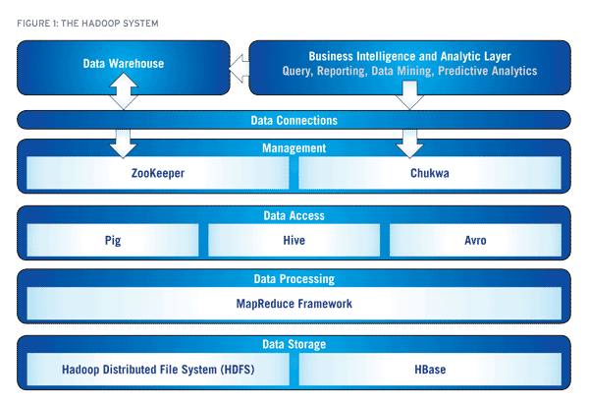
Hadoop and its eco system
.

Slide 4
HDFS Definition
The Hadoop Distributed File System (HDFS) is a distributed file system designed to run on
commodity hardware. HDFS is a distributed, scalable, and portable filesystem written in Java for the
Hadoop framework. It has many similarities with existing distributed file systems. Hadoop
Distributed File System (HDFS™) is the primary storage system used by Hadoop applications.
HDFS creates multiple replicas of data blocks and distributes them on compute nodes throughout a
cluster to enable reliable, extremely rapid computations. HDFS is highly fault-tolerant and is
designed to be deployed on low-cost hardware. HDFS provides high throughput access to
application data and is suitable for applications that have large data sets
HDFS consists of following components (daemons)
Name Node
Data Node
Secondary Name Node

Slide 5

Notes:
55
55

Slide 6
HDFS Components
Namenode:
NameNode, a master server, manages the file system namespace and regulates access to files by clients.
Meta-data in Memory
– The entire metadata is in main memory
Types of Metadata
– List of files
– List of Blocks for each file
– List of DataNodes for each block
– File attributes, e.g creation time, replication factor
A Transaction Log
– Records file creations, file deletions. Etc
Data Node:
DataNodes, one per node in the cluster, manages storage attached to the nodes that they run on
A Block Server
– Stores data in the local file system (e.g. ext3)
– Stores meta-data of a block (e.g. CRC)
– Serves data and meta-data to Clients
– Block Report
– Periodically sends a report of all existing blocks to the NameNode
Facilitates Pipelining of Data
– Forwards data to other specified DataNodes
Notes:
66

Slide 7
HDFS Components
Secondary Name Node
– Not used as hot stand-by or mirror node. Failover node is in future release.
– Will be renamed in 0.21 to CheckNode
– Bakup nameNode periodically wakes up and processes check point and updates the nameNode
– Memory requirements are the same as nameNode (big)
– Typically on a separate machine in large cluster ( > 10 nodes)
– Directory is same as nameNode except it keeps previous checkpoint version in addition to current.
– It can be used to restore failed nameNode (just copy current directory to new nameNode)
Notes:
77

Slide 8
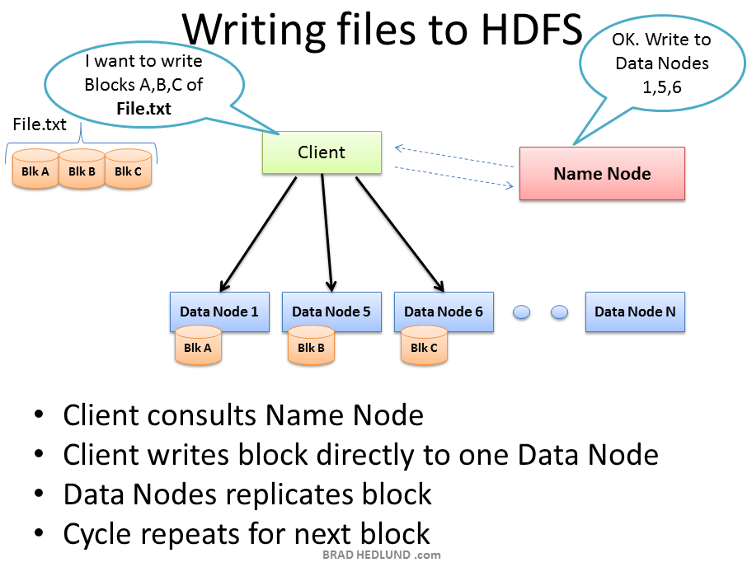

Slide 9
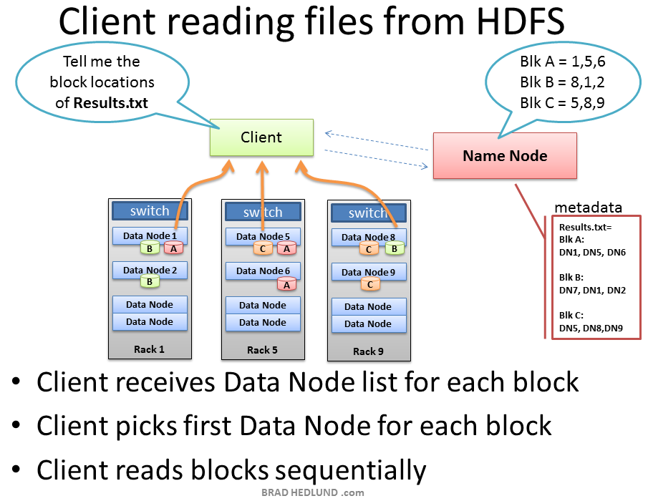

Slide 10
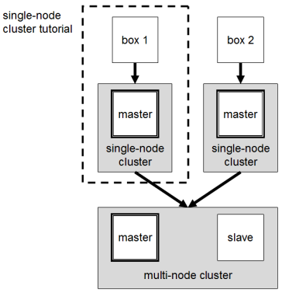
Hadoop Cluster Concepts

Slide 11
Clustering in Hadoop
Clustering in HADOOP can be achieved in the following modes
Local (Standalone) Mode-Used for Debugging
Pseudo-Distributed Mode- Used for Development
Fully-Distributed Mode- Used for Debugging,Development,Production
Notes:
1111

Slide 12
Standalone Mode
By default, Hadoop is configured to run in a non-distributed mode, as a single Java process.
This mode is useful for debugging.
Notes:
1212

Slide 13
Pseudo-Distributed Mode
Hadoop can also be run on a single-node in a pseudo-distributed mode where following Hadoop daemon runs in a separate Java process
NameNode
SecondaryNameNode
JobTracker
DataNode
TaskTracker
Notes:
1313

Slide 14
Fully-Distributed Mode
The Hadoop Distributed File System (HDFS) is a distributed file system designed to run on commodity hardware. It has many similarities with existing distributed file systems. However, the differences from other distributed file systems are significant. HDFS is highly fault-tolerant and is designed to be deployed on low-cost hardware. HDFS provides high throughput access to application data and is suitable for applications that have large data sets. HDFS relaxes a few POSIX requirements to enable streaming access to file system data. HDFS was originally built as infrastructure for the Apache Nutch web search engine project. HDFS is part of the Apache Hadoop project, which is part of the Apache Lucene project.
Notes:
1414

Slide 15
Installing Hadoop
Untar the hadoop-xyz.tar.gz file
#tar -xvzf hadoop-xyz.tar.gz
Set the hadoop environment variables
Notes:
1515

Slide 16
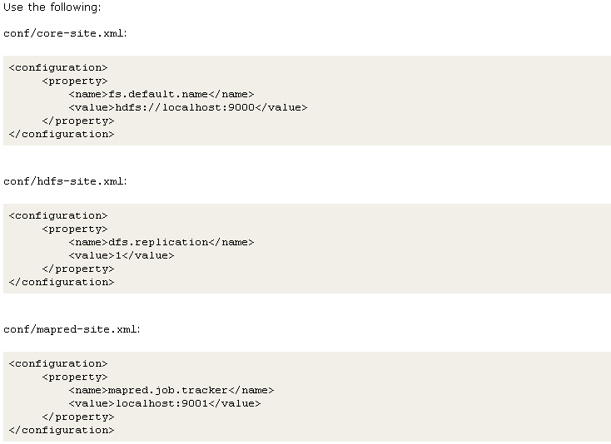
Creating a Pseudo-distributed mode cluster
Pseudo-distributed mode configuration

Slide 17
Executing a pseudo cluster
Format a new distributed-filesystem: $ bin/hadoop namenode -format
Start the hadoop daemons: $ bin/start-all.sh
Copy the input files into the distributed filesystem: $ bin/hadoop fs –copyFromLocal input1 input
Run some of the examples provided: $ bin/hadoop jar hadoop-examples.jar wordcount input output
Examine the output files:
Copy the output files from the distributed filesystem to the local filesytem and examine them: $ bin/hadoop fs -copyToLocal output output $ cat output/part-00000
When you're done, stop the daemons with: $ bin/stop-all.sh
Notes:
1717

Slide 18
Hadoop Web Interfaces
Hadoop comes with several web interfaces which are by default (see conf/hadoop-default.xml) available at these locations:
http://localhost:50030/ – web UI for MapReduce job tracker(s)
http://localhost:50060/ – web UI for task tracker(s)
http://localhost:50070/ – web UI for HDFS name node(s)
These web interfaces provide concise information about what’s happening in your Hadoop cluster
Notes:
1818

Slide 19
MapReduce Job Tracker web interface
The job tracker web UI provides information about general job statistics of the Hadoop cluster, running/completed/failed jobs and a job history log file. It also gives access to the ”local machine’s” Hadoop log files (the machine on which the web UI is running on).
By default, it’s available at http://localhost:50030/.
Notes:
1919

Slide 20
Task Tracker web interface
The task tracker web UI shows you running and non-running tasks. It also gives access to the ”local machine’s” Hadoop log files.
By default, it’s available at http://localhost:50060/.
Notes:
2020

Slide 21
MapReduce co-located with HDFS
Client submits MapReduce job
JobTracker
JobTracker and NameNode
need not be on same
node
NameNode
Slave node
A
Slave node B
Slave node
C
TaskTracker
TaskTracker
TaskTracker
DataNode
DataNode
DataNode
TaskTrackers (compute nodes) and DataNodes colocate = high aggregate bandwidth across cluster
Notes:
2121

Slide 22
Map Reduce Concepts
Job Tracker
The Job-Tracker is responsible for accepting jobs from clients,dividing those jobs into tasks, and assigning those tasks to be executed by worker nodes.
Task Tracker
Task-Tracker process that manages the execution of the tasks currently assigned to that node. Each Task Tracker has a fixed number of slots for executing tasks (two maps and two reduces by default).

Slide 23
Hadoop MapReduce: A Closer Look
Node 1
Node 2
Files loaded from local HDFS store
Files loaded from local HDFS store
InputFormat
InputFormat
file
Split
Split
Split
Split
Split
Split
file
file
file
RecordReaders
RR
RR
RR
RR
RR
RR
RecordReaders
Input (K, V) pairs
Input (K, V) pairs
Map
Map
Map
Map
Map
Map
Intermediate (K, V) pairs
Shuffling
Process
Intermediate
(K,V) pairs
exchanged by
all nodes
Intermediate (K, V) pairs
Partitioner
Partitioner
Sort
Sort
Reduce
Reduce
Final (K, V) pairs
Final (K, V) pairs
OutputFormat
OutputFormat
Writeback to local HDFS store
Writeback to local HDFS store

Slide 24
Input Files
Input files are where the data for a MapReduce task is initially stored
The input files typically reside in a distributed file system (e.g. HDFS)
The format of input files is arbitrary
Line-based log files
Binary files
Multi-line input records
Or something else entirely
file
file

